Slide 1
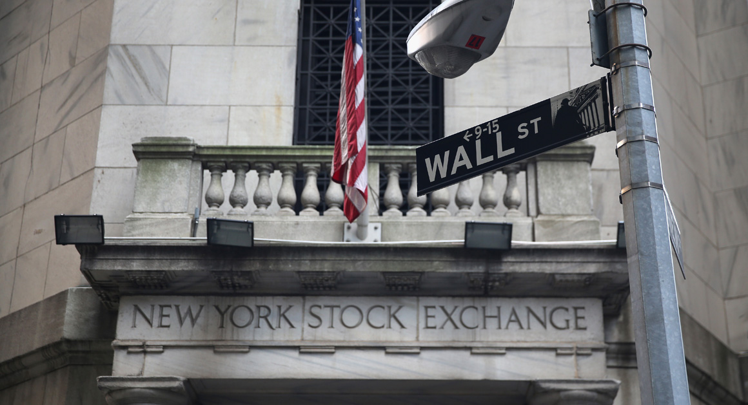
Earning Call Analytics
Harpreet Kaur, Parijat Rai, Chaitnay Singh, Gen Zhang

Slide 2
Team
2
Harpreet
Overview
Model
Analysis
Inferences.
Conclusion

Slide 3
Agenda
3
1
Executive Summary
2
Model
3
Industry Analysis
4
Inferences
5
Conclusion
Harpreet
Overview
Model
Analysis
Inferences
Conclusion

Slide 4

Executive Summary
4
Business Problem
Do public company quarterly earning calls predicts the performance of a company and how do mutual funds view the companies in balancing their portfolios?
Key Factors
Approach
1
Overall Industry Growth rate (macroeconomic factors) for the company
Develop Model
Evaluate factors affecting Mutual Fund Portfolio
2
Sentiment Score of the Earning calls
Compare Trends
3
Company Performance
(Stock Price)
Harpreet
Overview
Model
Analysis
Inferences
Conclusion
Notes:
Mention use organic growth

Slide 5
5
Model
Mutual Funds Stock Quantity
Scraping Earnings Call Transcripts
Score
Sentiment Analysis
Stock Prices
Regression
Mutual Funds Comparison
Parijat
Overview
Model
Analysis
Inferences
Conclusion
Notes:
Seattle, & Los Angeles

Slide 6

5
Model
Scraping Earnings Call Transcripts
Scraped Earning’s Call Data form www. SeekingAlpha.com
Initially Scraped using Beautiful Soup
Beautiful Soup allowed us to scrape some transcripts but we kept getting blocked off
Selenium saved the day!!
Parijat
Overview
Model
Analysis
Inferences
Conclusion
Notes:
Seattle, & Los Angeles

Slide 7
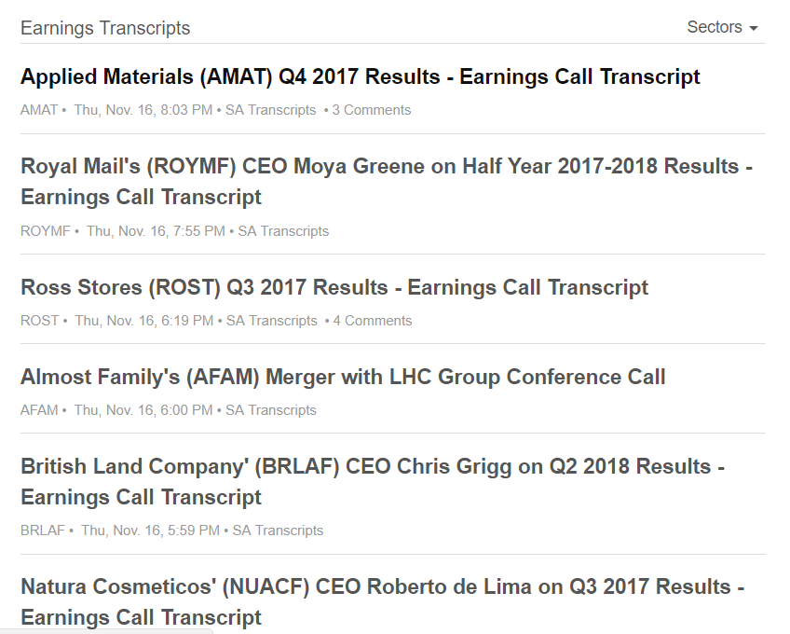
5
Model
Scraping Earnings Call Transcripts using Selenium
The box is a container containing the EC links
Parijat
Overview
Model
Analysis
Inferences
Conclusion
Notes:
Seattle, & Los Angeles

Slide 8

5
Model
Scraping Earnings Call Transcripts using Selenium
Once we had all the links, we located all the containers having the Earnings Calls Transcript body
Using xpath we were once again able to extract all the Earnings Calls data
Parijat
Overview
Model
Analysis
Inferences
Conclusion
Notes:
Seattle, & Los Angeles

Slide 9

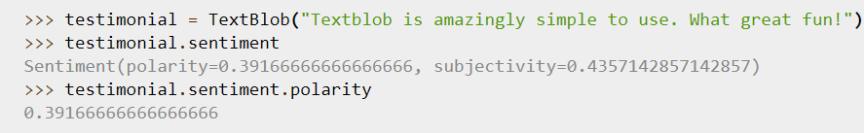
5
Model
Sentiment Analysis using Text Blob
TextBlob is a Python (2 and 3) library for processing textual data
It provides a simple API for diving into common NLP tasks such as part-of-speech tagging, noun phrase extraction, sentiment analysis, classification, translation etc.
The sentiment property returns a named tuple of the form Sentiment (polarity, subjectivity). The polarity score is a float within the range [-1.0, 1.0].
Parijat
Overview
Model
Analysis
Inferences
Conclusion
Notes:
Seattle, & Los Angeles

Slide 10
5
Model
Why Text Blob ?
We analyzed the sentiments Earning’s Call Transcript sentence by sentence and TextBlob was easy and user friendly
The results were easy to interpret
Also analyzed Google Cloud NLP, the results seemed almost the same
Parijat
Overview
Model
Analysis
Inferences
Conclusion
Notes:
Seattle, & Los Angeles

Slide 11
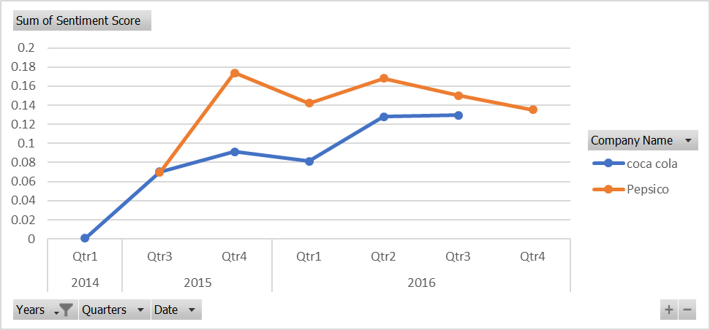
5
Industry Analysis – Food & Beverages
The sentiment analysis score for Earnings Call Transcript from the quarter follow similar trends
Chaitnay
Overview
Model
Analysis
Inferences
Conclusion
Notes:
Seattle, & Los Angeles

Slide 12
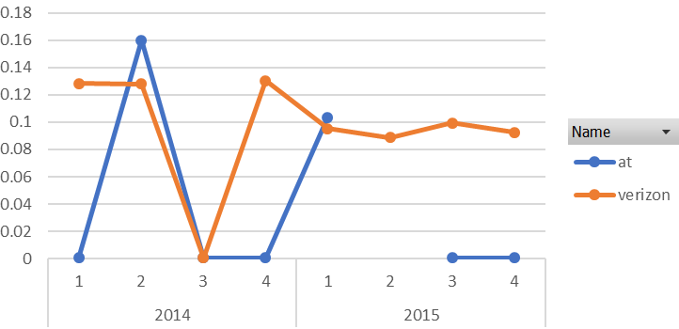
5
Industry Analysis - Logistics
The sentiment analysis score for Earnings Call Transcript from the quarter follow similar trends
Chaitnay
Overview
Model
Analysis
Inferences
Conclusion
Notes:
Seattle, & Los Angeles

Slide 13
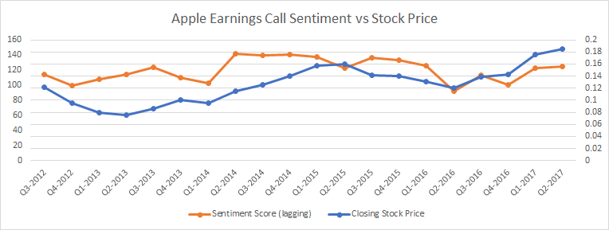
5
Industry Analysis - Technology
2
The sentiment analysis score for Earnings Call Transcript from the quarter impacts the closing stock price of company.
Chaitnay
Overview
Model
Analysis
Inferences
Conclusion
Notes:
Seattle, & Los Angeles

Slide 14
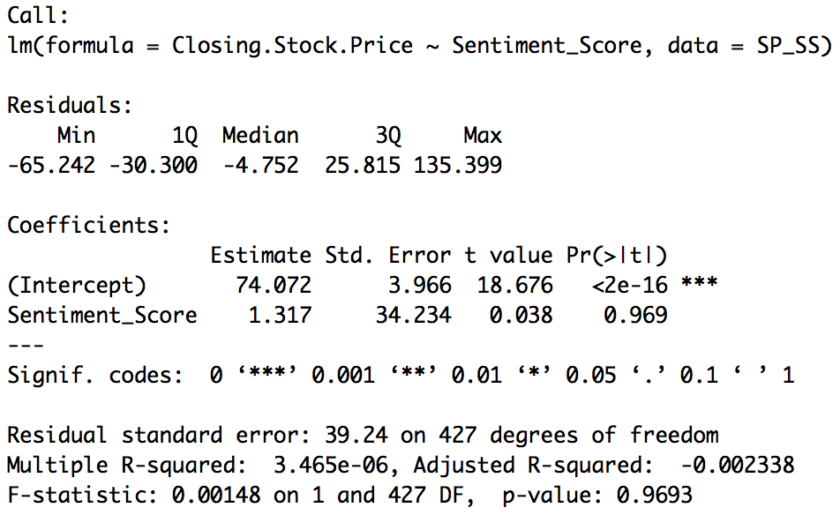
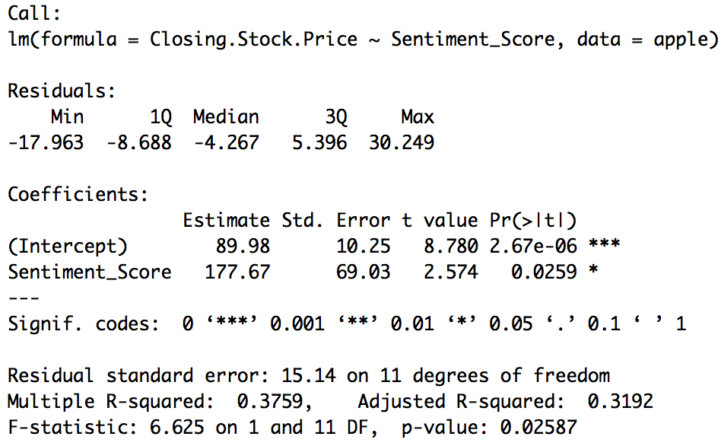
5
Regression – Stock Price vs Sentiment Score
Regression Model across Industries
Regression Model for Apple (Technology Industry)
Chaitnay
Overview
Model
Analysis
Inferences
Conclusion
Notes:
Seattle, & Los Angeles

Slide 15
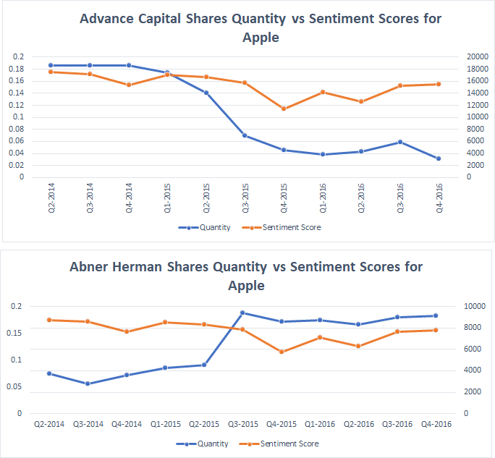
5
Industry Analysis – Mutual Funds
The Quantity of stocks of a company in a mutual fund portfolio majorly follows the same trend as the sentiment analysis score for Earnings Call Transcript.
Chaitnay
Overview
Model
Analysis
Inferences
Conclusion
Notes:
Seattle, & Los Angeles

Slide 16
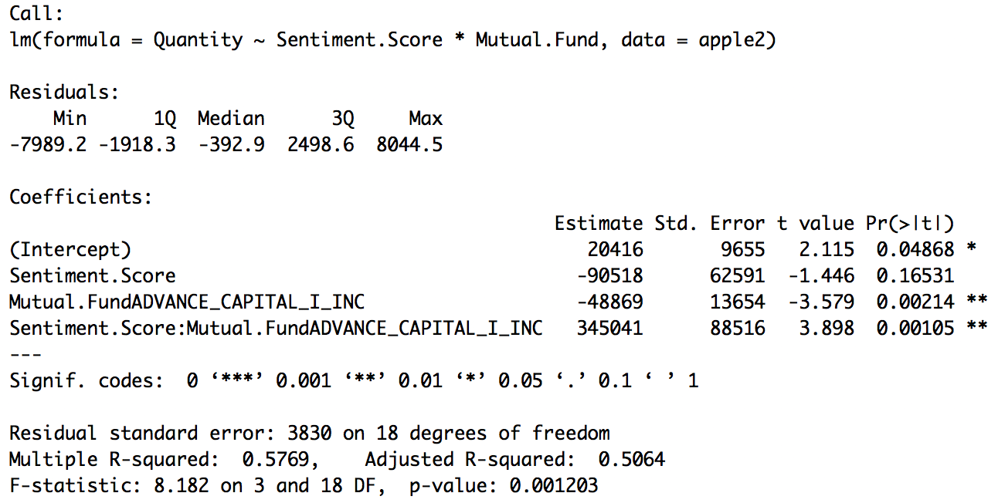
5
Regression – Quantity vs Sentiment Score
Chaitnay
Overview
Model
Analysis
Inferences
Conclusion

Slide 17
5
Inferences & Limitation
Although Apple shows some significance, the sentiment scores for most companies seem to have little or no impact on the price of stocks when taken as a performance measure
The tone of the Earnings Call speech is portrayed in a positive manner even though the company may not be performing well making it difficult to distinguish between a positive Earnings Call Speech and a negative one
The Sentiment Analysis needs to be thorough and robust. The results of our TextBlob and Google Cloud NLP were very close to each other telling us that the algorithm had not fully picked up the speech nuances
There were many cases of missing EC Transcripts or 13F filings for Mutual Funds making it difficult to come up with a fair and controlled analysis
Gen
Overview
Model
Analysis
Inferences
Conclusion

